Slide 1

AIRFLY INSIGHTS
Data Visualization and Analysis of Airline Operations

Slide 2
Table of Content
Project Overview
Business Objective
Dataset & Workflow
Data Preparation
EDA & Delay Analysis
Route & Airport Insights
Seasonal and Cancellation Trends
Dashboard Overview
Key Insights
Recommendations & Future Scope
Conclusion

Slide 3
Project Overview
The project objective is to analyze large-scale airline flight data to uncover operational trends, delay patterns, route congestion, and cancellation reasons using data visualization and business intelligence techniques.
Business Objectives
The airline industry produces a large amount of flight data every day, such as schedules, delays, cancellations, and airport traffic details. Without proper analysis, it becomes difficult to understand delay patterns, airport congestion, and seasonal issues.
The main objective of this project is to analyze this raw flight data and convert it into meaningful insights that can help improve on-time performance, reduce cancellations, optimize routes, and improve passenger experience.

Slide 4
Dataset Overview
5.8M
2.4GB
745MB
Flight Records
Raw Data Size
Optimized Size
2015 U.S. Airlines Flights dataset with 31 operational features per record
Original memory footprint before preprocessing and optimization
Final analytical dataset after cleaning, feature engineering, and datatype tuning
Key Features
AIRLINE
ORIGIN_AIRPORT & DESTINATION_AIRPORT (airports)
FLIGHT_NUMBER, TAIL_NUMBER
DISTANCE (miles)
DEPARTURE_DELAY & ARRIVAL_DELAY (minutes)
LATE_AIRCRAFT_DELAY, AIR_SYSTEM_DELAY, WEATHER_DELAY, SECURITY_DELAY
CANCELLATION_REASON (Weather, Carrier, NAS, Security)
ARR_STATUS (Early, On-Time, Delayed, Cancelled, Diverted)

Slide 5
Project Workflow: Milestone Overview
Data Foundation and Cleaning
Visual Exploration and Delay Analysis
Route, Cancellation and Seasonal Insights
Report and Dashboard

Slide 6
Data Foundation & Cleaning
Data Aquisition
Key Achievements
Load CSVs using pandas (5.8M records)
Explore schema, column types, memory size, and null distribution
Overiewed the Statistical summary
69% Size Reduction
Add New Features
From 2.4 GB raw to 745.2 MB optimized
Arrival Status, Routes, Part of Day, etc
Preprocessing & Feature Engineering
Zero Nulls
35 Columns
Clean final dataset with no missing values
All optimized and ready for downstream analysis
Handle nulls in delay and cancellation columns
Derive new features: Month, Day of Week, Hour, Route
Reformat datetime columns (HHMM → usable format)
Optimize data types (category, int8, int32, float32)

Slide 7
EDA(Univariate and Bivariate)& Delay Analysis
Exploratory Data Analysis
Analyzed flight distribution by airline, origin airport, and route
Visualized arrival and departure delay spread
Compared on-time vs delayed vs cancelled flights
Identified top busy airports and frequently used routes
Performed univariate and bivariate delay analysis
Key Insights
Top Airlines: Southwest (1.26M), Delta (876K), American (726K)
Top Routes: SFO→LAX (13,744), LAX→SFO (13,457), JFK→LAX (12,016)
Busiest Months: July & August peak; February lowest
Top Airports: ATL, ORD, and DFW lead in total flight counts
Delay Analysis
Measured average departure and arrival delay
Compared delay performance across airlines
Identified most delay-prone routes
Analyzed airport congestion impact
Evaluated monthly and seasonal delay patterns
Carrier Delays: Frontier Airlines highest at 27 min avg
Weather Delays: JFK, ORD, DFW most severely affected
Temporal Patterns: Evening flights average 13.8 min delay
Worst Route: JAD→TTN averages 387 min delay

Slide 8
Route & Airport Level Analysis
Route-Level Analysis
Analyzed high-frequency flight routes
Identified routes with highest average delays
Compared cancellation trends across major routes
Evaluated route performance by on-time % and delay %
Highlighted busiest origin → destination pairs
Key Insights
SFO-LAX: Busiest corridor (13,744 flights); LAX-JFK bidirectional (12,015+ each way)
Airport-airline delay heatmaps: 20 airports × 14 airlines
Geographic map: bubble size = volume, color = avg delay
Delay hotspots: JFK, ORD, DFW flagged across all metrics
Airport-Level Analysis
Measured airport traffic volume and operational load
Compared delay %, cancellation %, and on-time %
Identified hub airports with congestion issues
Evaluated airport contribution to network-wide delays
Compared origin vs destination airport performance

Slide 9
Seasonal & Cancellation Analysis
Seasonal Trends
Analyzed monthly and seasonal flight performance patterns
Compared delay trends across summer, winter, and holiday periods
Identified peak traffic seasons with higher congestion
Measured seasonal variation in on-time performance
Evaluated weather impact on delay frequency
Key Insights
Winter peak: 40,562 cancellations (Feb alone: 20,517)
Fall lowest: 9,128 cancellations — most reliable season
December & January: Holiday period adds 20,045 combined cancellations
Cancellation Trends
Compared cancelled vs completed flight volume
Identified months with the highest cancellation rate
Analyzed airport-level weather-related cancellations
Evaluated airline-wise cancellation performance
Measured seasonal spikes in cancellation probability

Slide 10
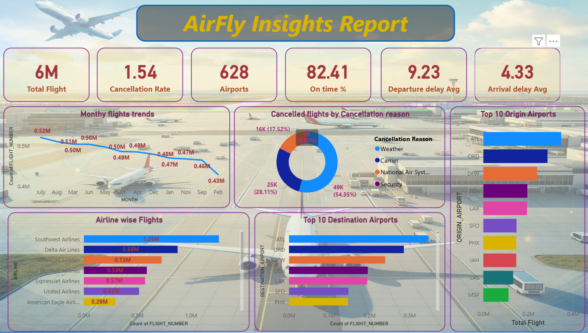
Power BI Dashboard Overview
Dashboard Highlights
Designed an interactive Power BI dashboard for airline performance monitoring
Included KPI cards for:
Total Flights
Delay %
Cancellation Rate
On-Time %
Added slicers for Airline, Airport, Route, and Month
Visualized route and airport performance using bar charts, matrix, and line charts
Built delay and cancellation trend analysis visuals
Enabled drill-down analysis for airline and airport-level insights

Slide 11
Recommendations & Future Scope
Strategic Recommendations
Improve turnaround efficiency at high-delay hub airports
Add seasonal buffer schedules during winter and holiday months
Strengthen weather-risk monitoring for sensitive airports
Optimize staffing and gate allocation during peak hours
Use route-level KPIs for proactive delay management
Future Scope
Buil real-time flight monitoring dashboards
Integrate live weather and ATC data sources
Apply ML-based delay prediction models
Add airport-wise anomaly detection alerts
Expand analysis to passenger satisfaction and cost impact

Slide 12
Conclusion
Successfully transformed 5.8M+ airline records into actionable operational insights, identified major delay and cancellation drivers, and extended the analysis into Power BI dashboards for stakeholder decision-making.

